Slide 1
2019 Fall ENME-462 Studio
Section 0101, FR, SH
Wednesday 1:00 – 2:50 PM
KEB 2111

Slide 2
Introduction
Name: Xie Zheng
Email: xiezheng@umd.edu
Office Hours:
Friday 9:30 – 11:30 AM
GLM 0103 (Vibration Lab)

Slide 3
Grading Policy
 | Studio attended | Studio not attended
HW not submitted | 5 | 0
HW submitted | 10 | 0
Studio attendance is mandatory , and students who miss a studio session will receive no credit for that studio. However, the lowest studio score will be removed from the grade calculation.

Slide 4
Attendance – Section 0101
Sign up sheet
Name | Signature | Check mark
Tony Stark | Tony Stark
Stephen Strange | Stephen Strange
Bruce Banner | Bruce Banner
Peter Quill |  | x
: studio attended & HW finished in class
: studio attended & HW have not finished
Studio-n HW is due by the begin of Studio-n+1

Slide 5
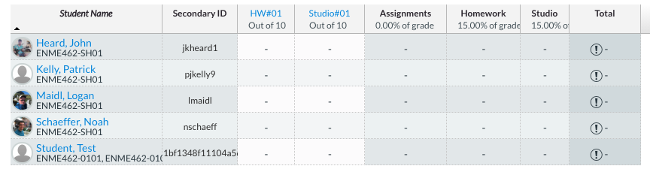
Attendance – FR, SH
submit HW as a proof of attendance
During the studio time
Studio-n HW is due by the begin of Studio-n+1

Slide 6
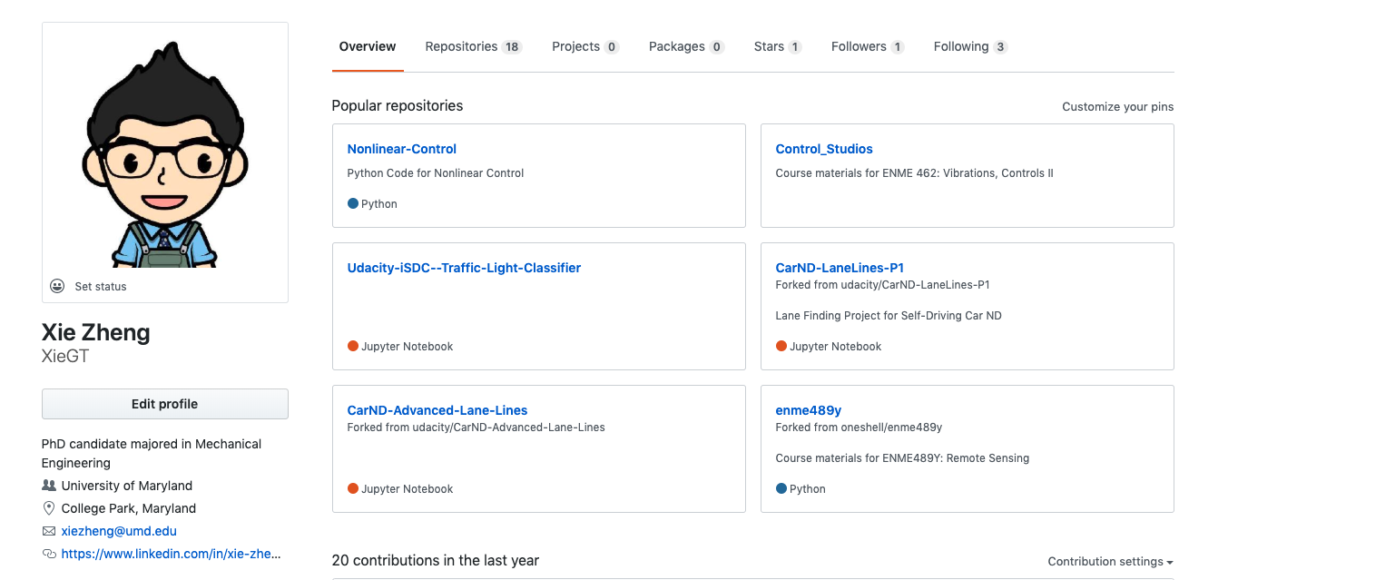
GitHub
https://github.com/XieGT/Control_Studios

